Slide 1
It’s Your Future, You drive
Find lifelong success with a rewarding auto career
Notes:
This template uses Lato Font. You can download for free here: http://www.latofonts.com/lato-free-fonts/. For information on how to embed fonts in the presentation go to: https://support.microsoft.com/en-us/kb/826832

Slide 2
Redefining the auto industry
Notes:
Use this as a section or call out quote slide.

Slide 3
Today’s auto careers
Technology-focused
High-end vehicles today incorporate 100 million lines of software code—4x as many as a fighter jet
Perfect for problem-solvers
Working on repairs or working with customers, you’re always challenged to find solutions
Fast-paced and varied
Many possible career paths, constant technological change, portable skills you can take anywhere

Slide 4
Huge Industry potential

Slide 5
Variety of career options
Auto service tech
Collision tech
Paint tech
Service advisor
Collision estimator
Auto shop owner
Parts professional
Automotive machinist
Manager
Sales representative
Instructor
Descriptions and salary information at CarCareers.org

Slide 6
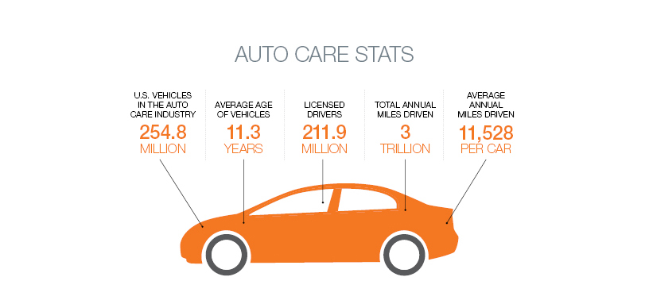
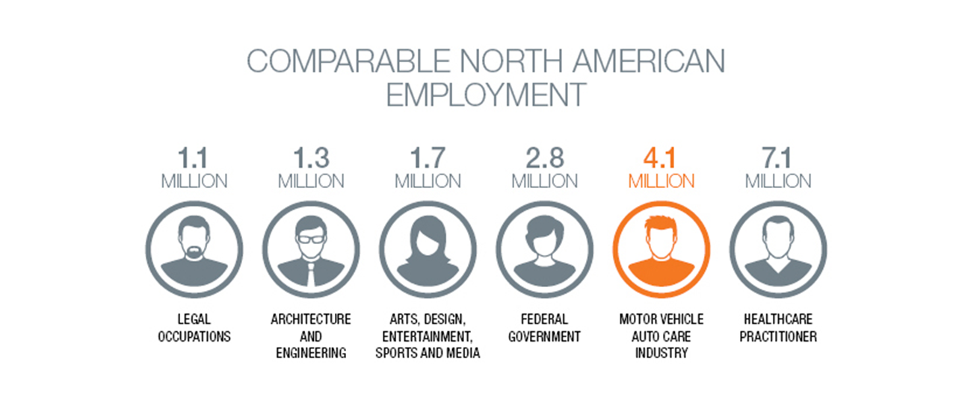

Slide 7
Why Choose Automotive?
Notes:
Use this as a section or call out quote slide.

Slide 8
Why You’ll Love A Job in Auto
Keep up with constantly-changing technology
Find satisfaction in helping customers get their vehicles back on the road
Explore endless opportunities for advancement
Enjoy variety and challenge every day
Turn your love of cars into a career

Slide 9
Automotive Earning Potential
In high demand: you’re likely to land a job while still in school
Many entry-level jobs start around $30,000
Professionals with experience: over $60,000
Top Performers: earning over six-figure annual incomes

Slide 10
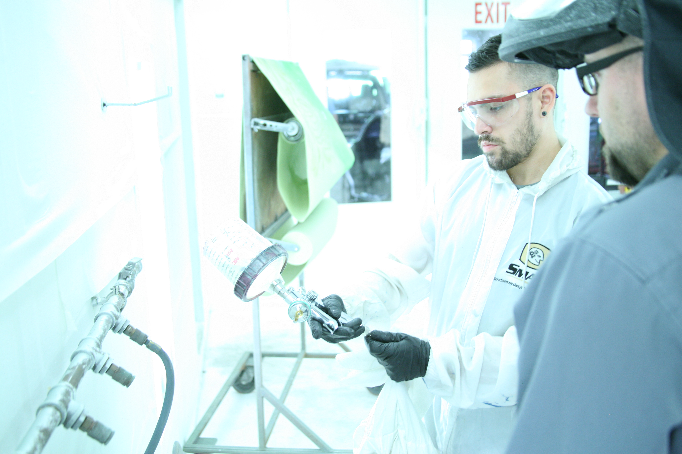
What it takes to succeed
Technical savvy
Problem-solving abilities
Solid background in English, math and computers
Strong communication skills
Ability to work as part of a team – and independently
Commitment to continuing education

Slide 11
Automotive Education
Notes:
Use this as a section or call out quote slide.

Slide 12
Benefits of an Auto Education
Affordability
(Two-year programs)
Passion
(Career where you do what you love)
Industry Demand
(Openings now with strong earning potential)

Slide 13
Auto Programs in Minnesota
Over 30 programs statewide
Most are in two-year public community and technical colleges
Automotive service or collision repair programs to fit your interests
Click
“Get Started” CarCareers.org
for a full list.

Slide 14
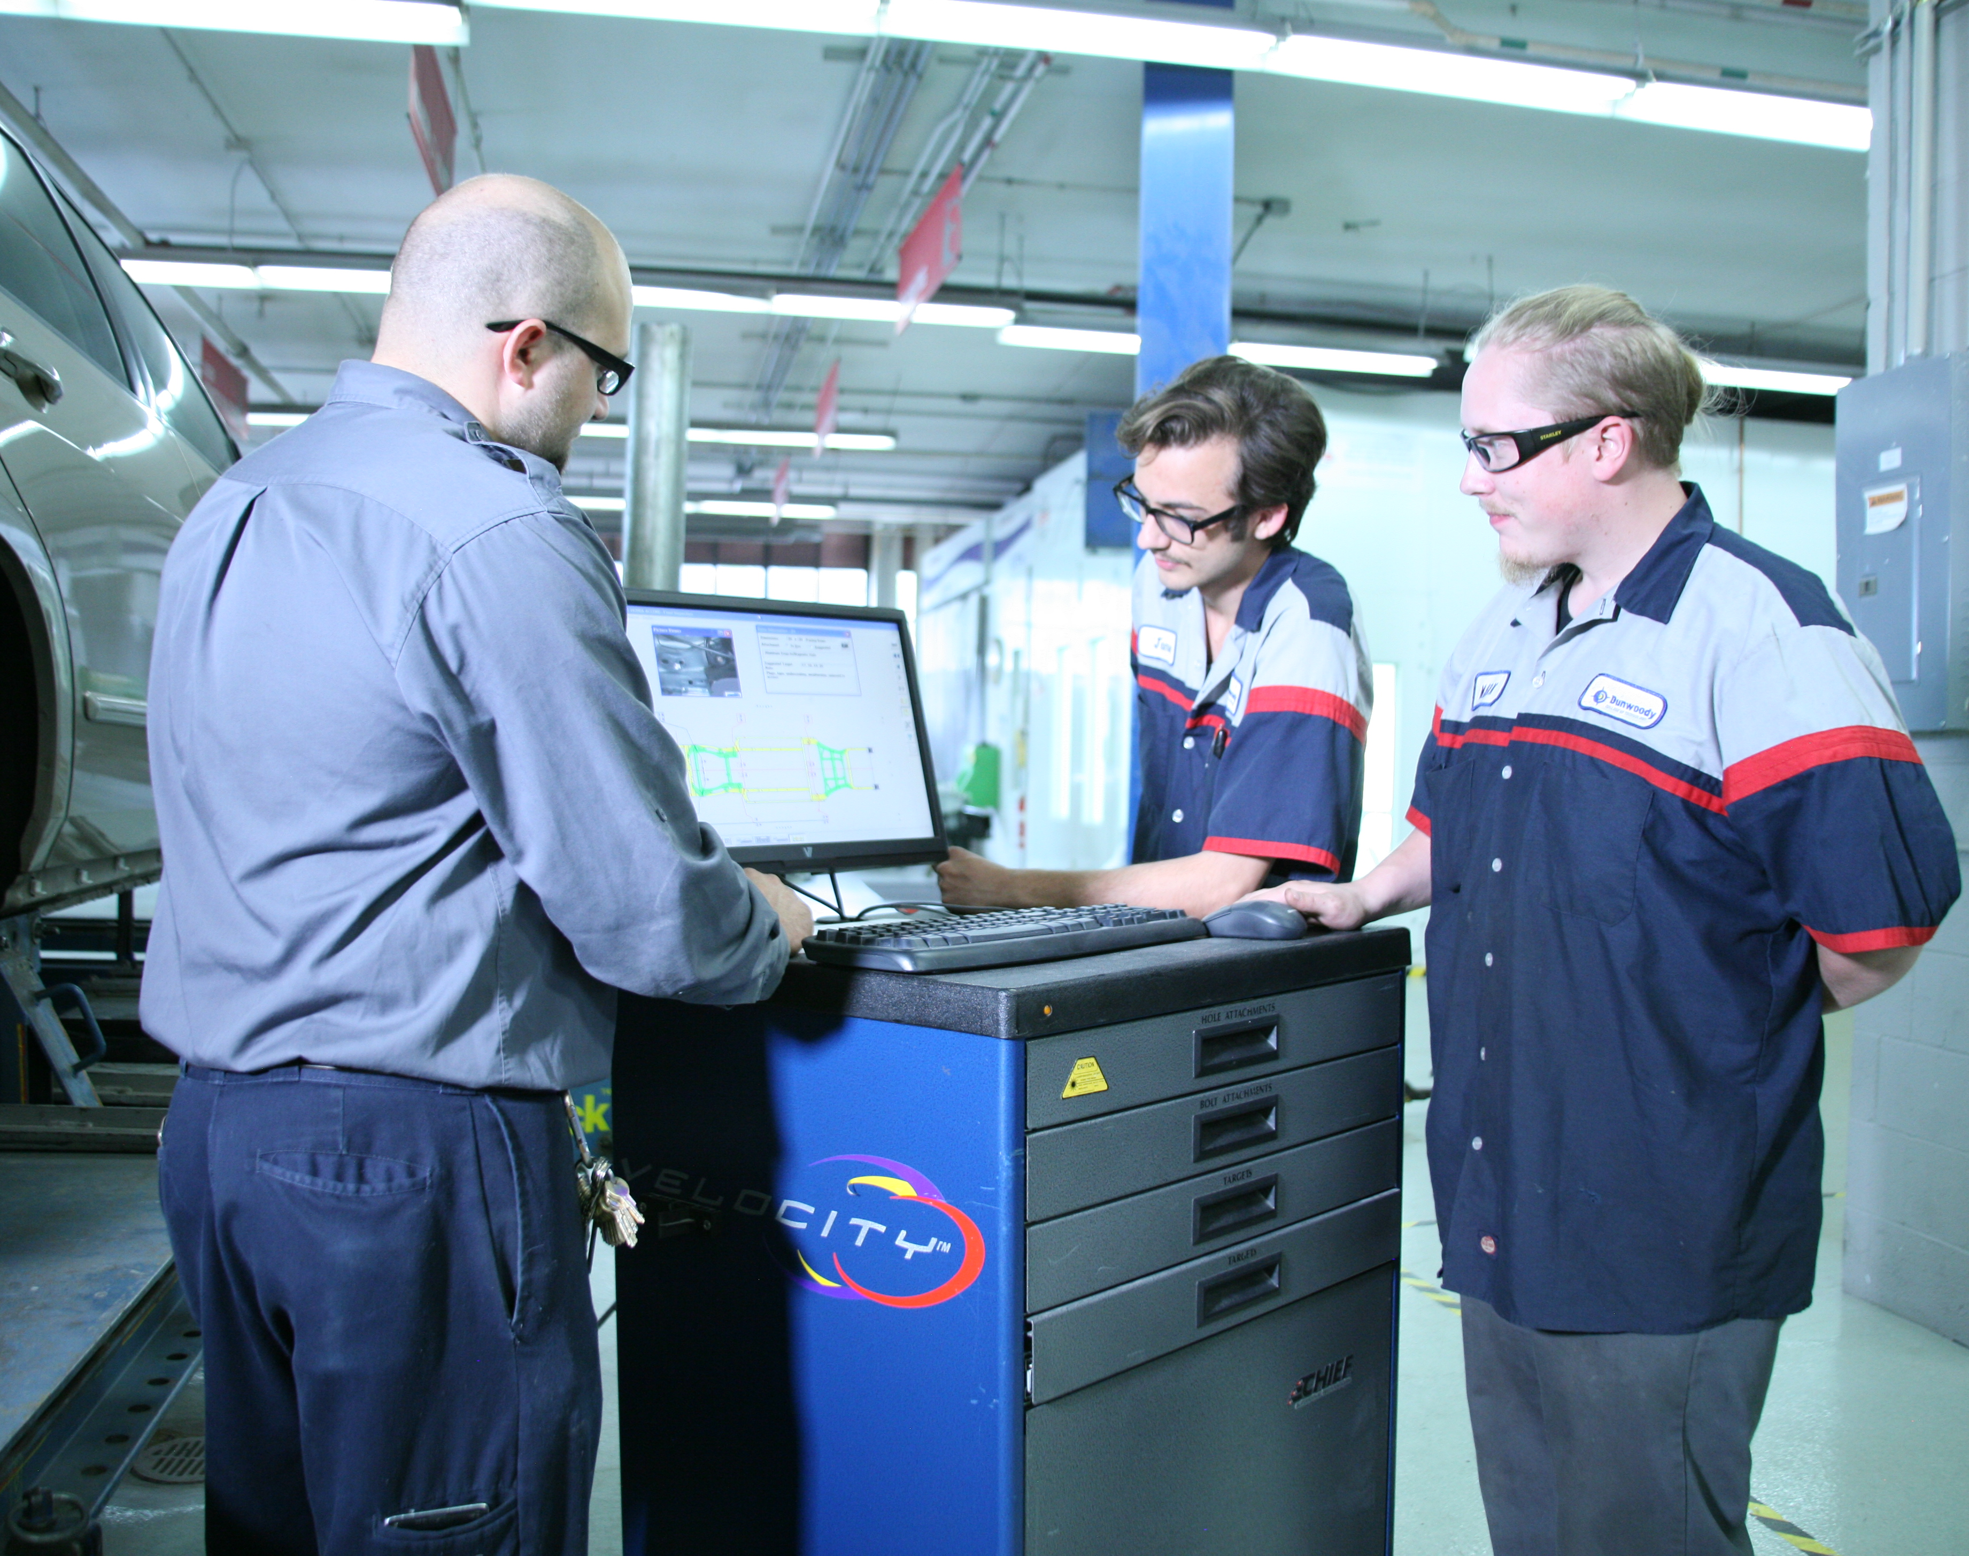
Scholarships
An automotive scholarship can help pave your way to a rewarding career. Numerous companies and organizations in the automotive service and collision repair industry offer scholarships for students training to enter the industry.
Visit
Automotivescholarships.com
to apply.

Slide 15
How to Get Started Today
Meet local professionals on tours, interviews or job shadowing via MNCARS. Contact us at info@carcareers.org.
Visit CarCareers.org to discover your opportunities and learn more about auto careers.
Connect with us on Facebook.com/CarCareers and Instagram @CarCareers
ASK QUESTIONS! Ask your guidance counselor or teacher about a career in the auto industry. Or visit CarCareers.org to submit your questions to local pros.

Slide 16
About MNcars
Minnesota Careers in Automotive Repair and Service (MNCARS) is ensuring a future workforce for our state’s auto industry by sharing the latest info about auto education and rewarding careers in the industry.

Slide 17
It’s your future, you drive
Notes:
To add a full page image: Crop image to 10x7.5 and Insert Picture. Copy/paste the graphic from this page on top of picture.

